Slide 1





Data Science: A Career to Consider
Chris Engelhardt, Ph.D.
Lead Data Scientist, CARFAX, Inc.
github.com/chris-engelhardt
chrisengelhardt@carfax.com
linkedin.com/in/chrisengelhardt1
@EngelhardtCR

Slide 2
Roadmap
What is data science?
Day-to-day activities
Transition from academia to data science
Practical advice

Slide 3
What IS data science?

Slide 4
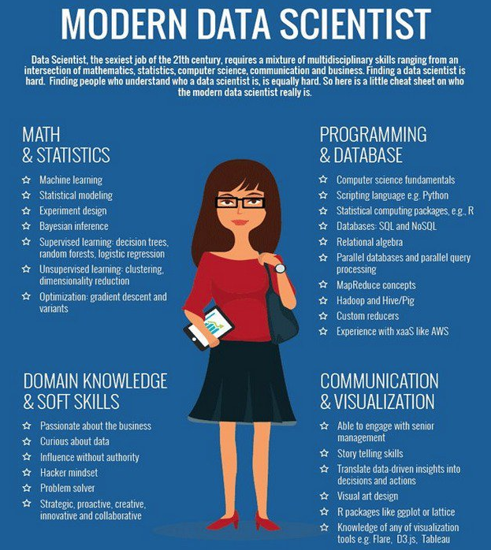
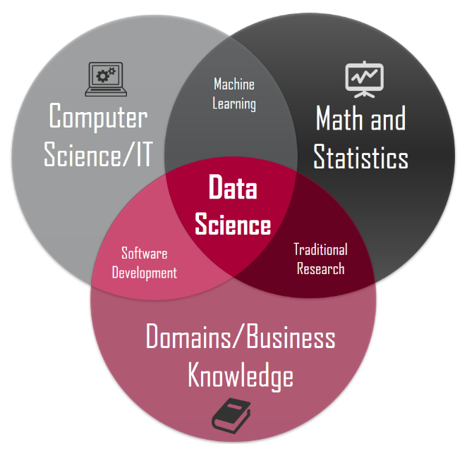

Slide 5
“Data science is an exciting discipline that allows you to turn raw data into understanding, insight, and knowledge.”
Grolemund & Wickham, 2017, R for Data Science

Slide 6
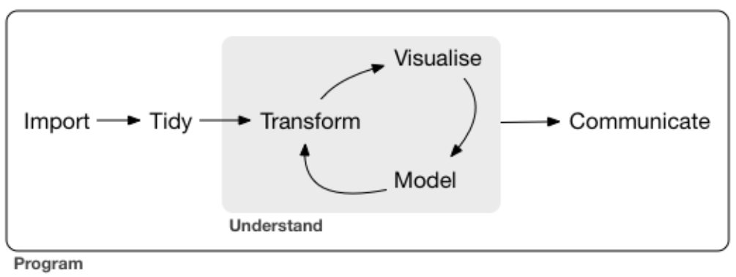
Grolemund & Wickham, 2017, R for Data Science

Slide 7




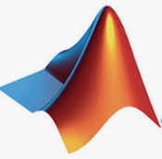
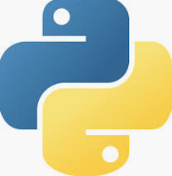


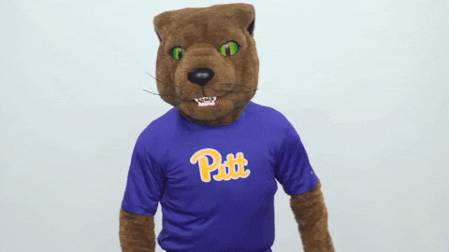

An academic workflow
Do analysis
Finish data collection
Publish results

Slide 8
Why might you consider a career in data science?

Slide 9

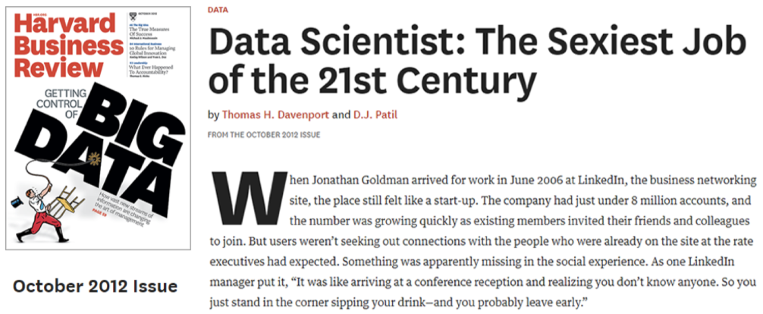
1. The field is

Slide 10
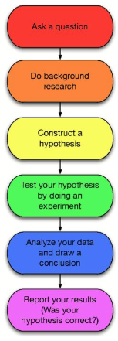
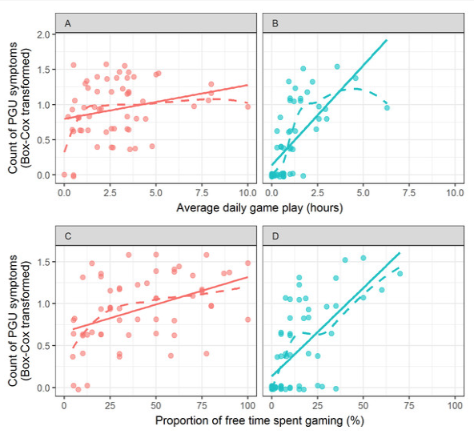


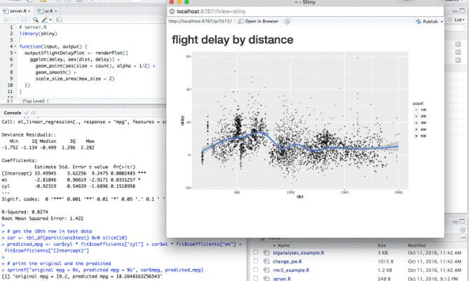
What makes it sexy exactly?
Data skills are in extremely high demand

Slide 11
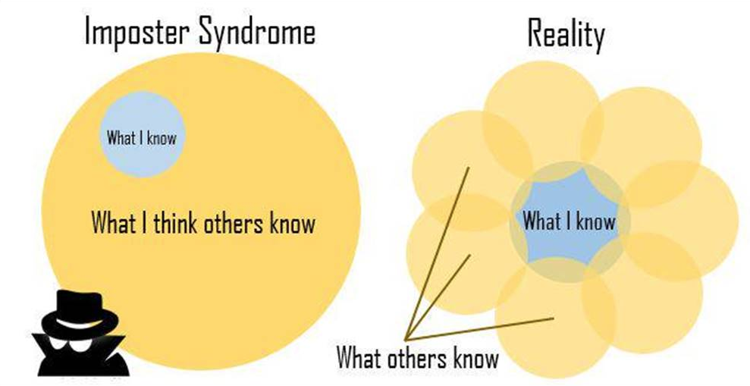
*YOU* are valuable!

Slide 12
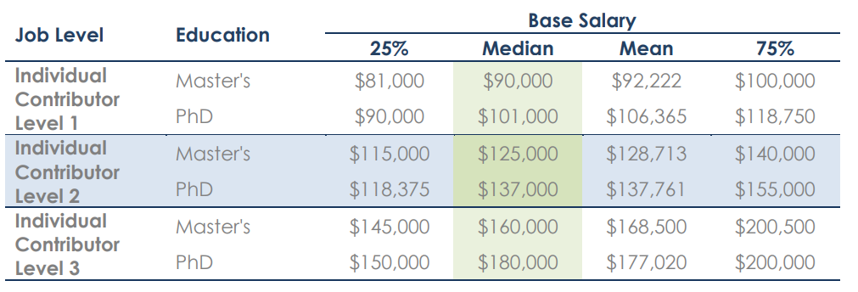
2. Compensation

Slide 13
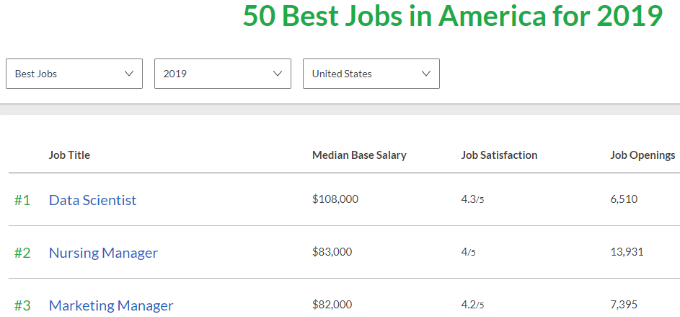
3. Top job since 2016
2016
&
2017
&
2018

Slide 14








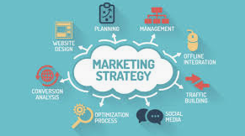
4. Work flexibility

Slide 15
5. Impact millions of people
Help people make decisions

Slide 16
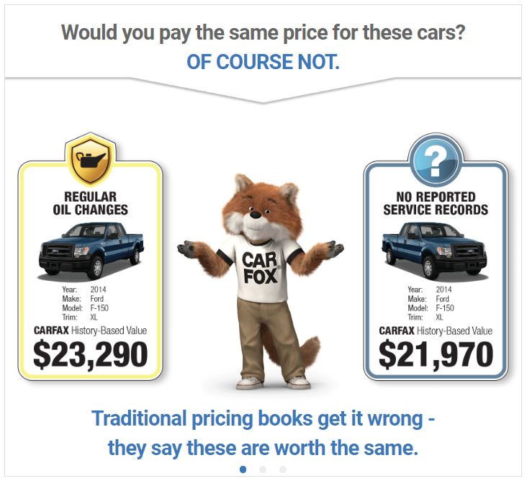
How much should I pay?

Slide 17


Slide 18

Summary
Data science skills are
Pay is good
Job satisfaction is high
Flexibility to work on different problems
Your work can make a huge difference in people’s lives

Slide 19
The day-to-day life of a
data scientist

Slide 20
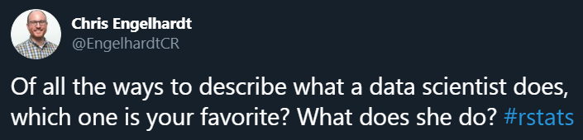

Slide 21
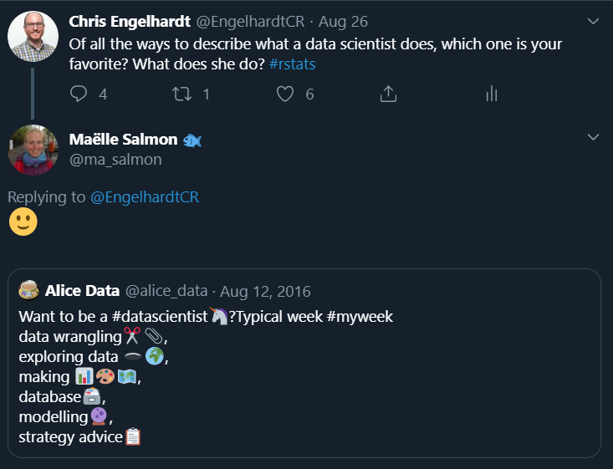

Slide 22
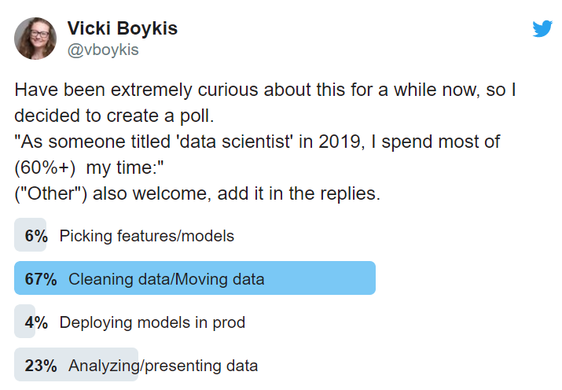
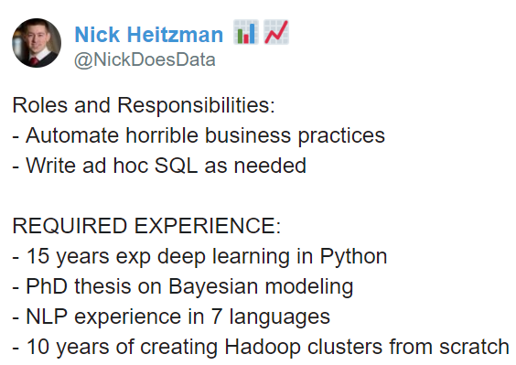
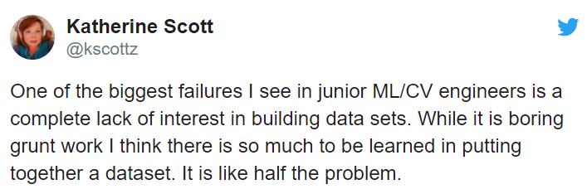

Slide 23

But…programmatically

Slide 24
Work on ill-defined business questions

Slide 25
Questions such as…
How can we identify fraud?
What is the value of this vehicle?
How can we identify our market segments?
How can we make this business process more efficient?
How can we improve this product?
How should we prioritize these business customers?

Slide 26
Answer them using…

Slide 27
Grolemund & Wickham, 2017, R for Data Science

Slide 28
Summary
A fair amount of data manipulation and movement
Programming
Explain complex concepts/results to business people
Bring data to bear on business challenges and opportunities
Some machine learning/predictive analytics

Slide 29
Transition from academia to data science

Slide 30

Me, on 2015-08-28 (ish)

Slide 31
Leaving academia is scary!
You are trained to be an academic
Who can I even talk with about my not being “all in?”
You might think you are a failure or could not make it
What will other people think of my decision?

Slide 32


Slide 33
On the differences

Slide 34
Data science
Academia
Write code and develop software
Model for prediction
Compute on large, remote data
Content with good enough
Results have impact quickly
Few understand what you do
Business acumen
Write papers and submit grants
Model for inference
Compute on small, in-memory data
Fine-tune measurements and models
Results take months/years to publish
Most people understand what you do
Academic acumen

Slide 35
On the similarities

Slide 36
Similarities
Produce knowledge that makes people informed
Face many, many data quality issues
Design studies and analyze results
Write narratives around why your work is valuable
Juggle many projects and priorities
Work with amazing collaborators

Slide 37
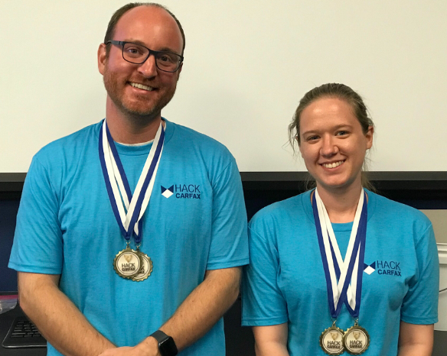
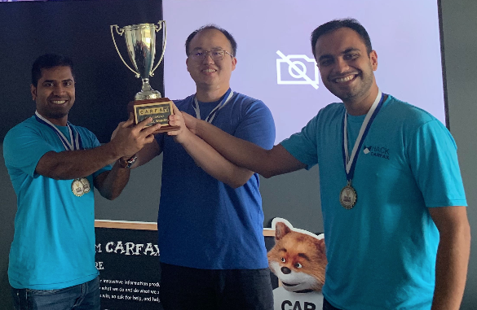
CARFAX hack-a-thon: June 2019

Slide 38
Summary
Leaving academia can be daunting, but people will support you (especially me!)
Expect a few differences but many similarities

Slide 39
Practical Advice

Slide 40

If I could…

Slide 41
Remember when I said data science skills are ?

Slide 42


Slide 43
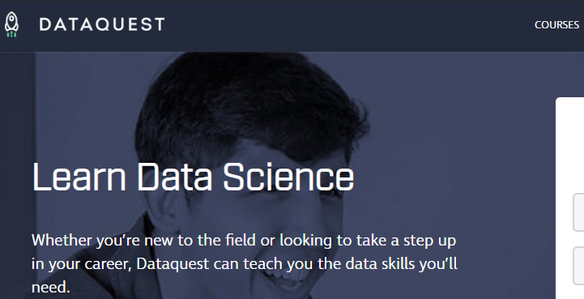
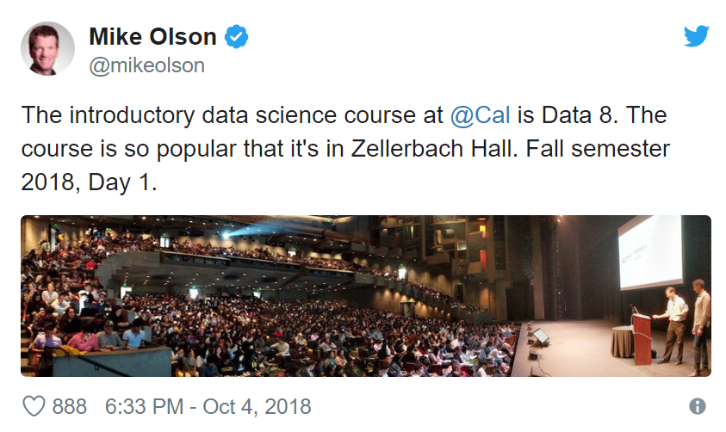
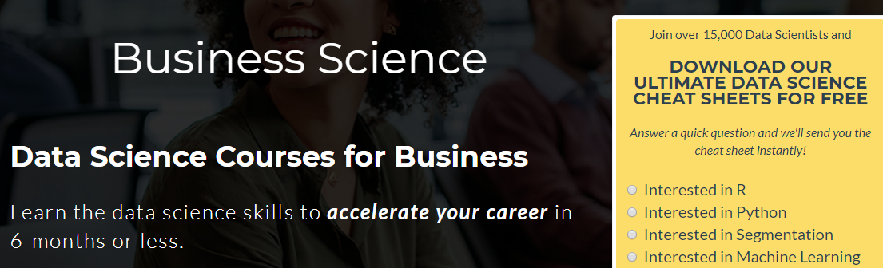
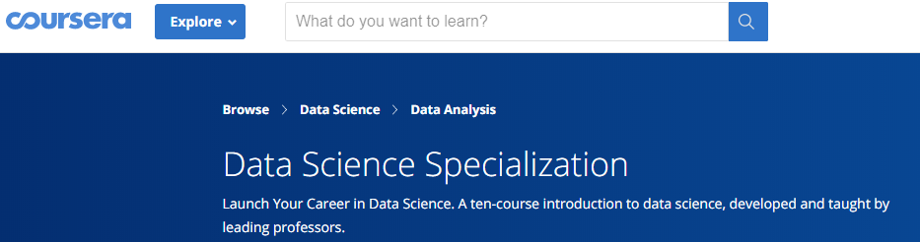
The junior talent is exploding

Slide 44
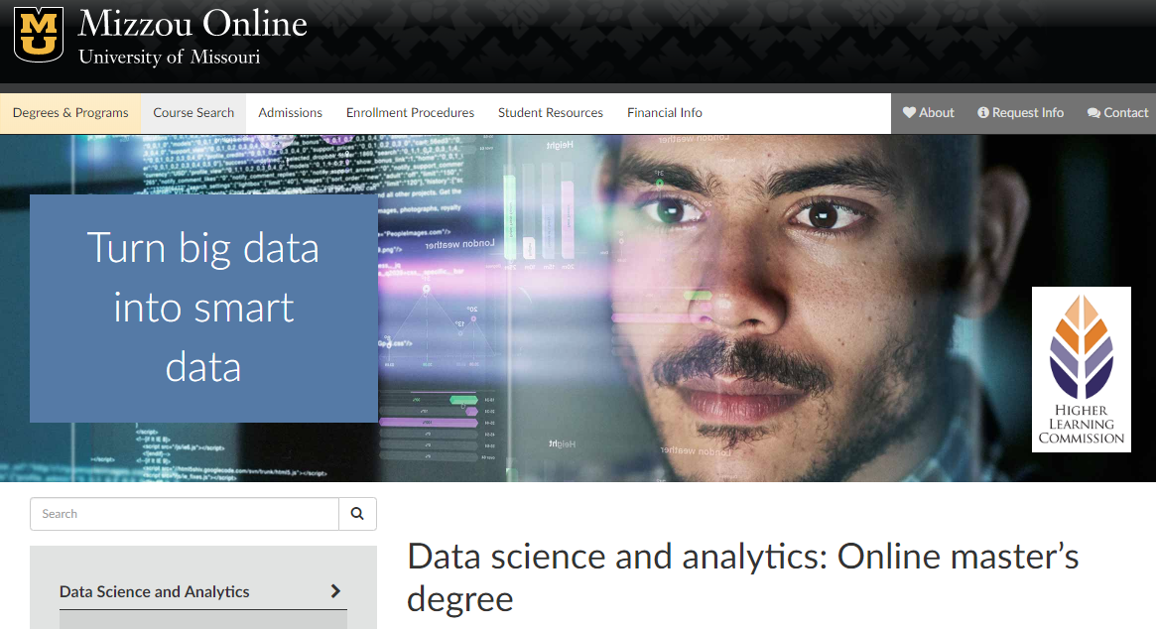

Slide 45
Q: How can you compete?
A: Do something different!

Slide 46


Competing: be social
Make yourself known
Network, network, network
*Never* send in a resume without a point of contact
Know anyone with connections?

Slide 47
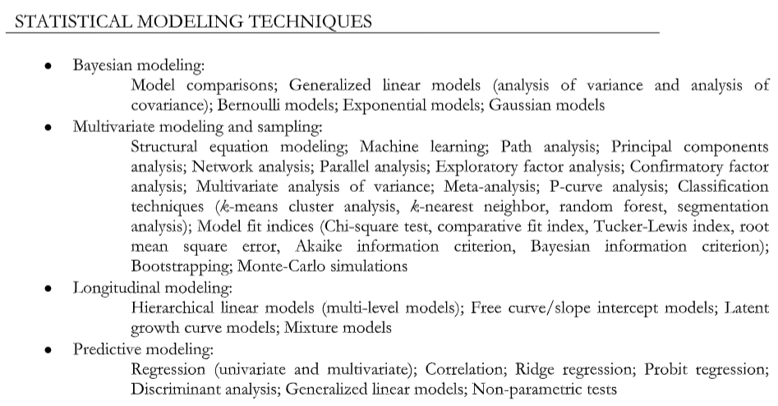
Competing: Business impact

Slide 48
Competing: Business impact

Slide 49
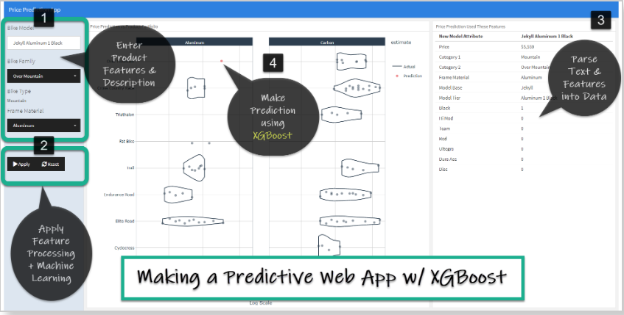
Competing: Business impact
Data science internship
Side project (show you can do the job)
Recommendation is to make an interactive web application that:
Joins at least 2 data sources
Does feature engineering
Fits a model that predicts an important business outcome
Displays model performance and predictions
Gets deployed (can be free)

Slide 50
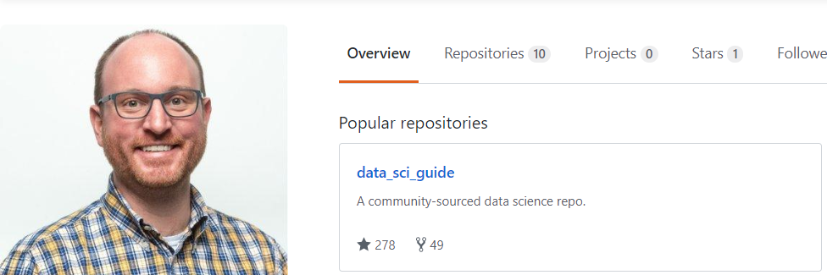
Competing: as a grad student
Tackle your next problem with R (or Python) and get your work under version control and on GitHub (open science FTW)
github.com/chris-engelhardt

Slide 51
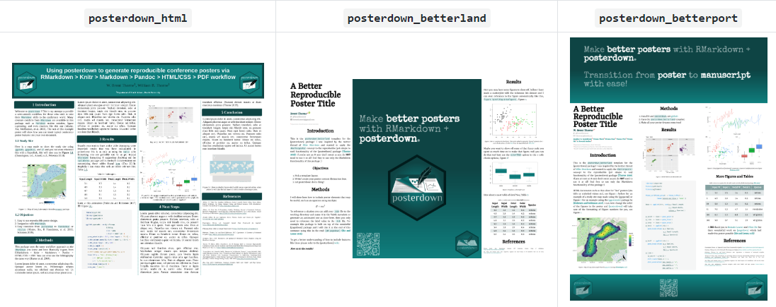
Competing: as a grad student
Create something programmatically
Save yourself time
Have your poster or paper update itself automatically!

Slide 52
Summary
Make yourself known and have a brand
Compete socially and show business impact
You can improve today your academic workflow with programming

Slide 53
Key Points to Remember
The demand for data skills is not going anywhere
Many non-academic job options that are enjoyable, rewarding, and allow you to grow
Hardly anyone in this world has your background and skill set

Slide 54

Mizzou psychology department
CARFAX
Dr. Kim Bodner

Slide 55
Recommended resources
R for Data Science: https://r4ds.had.co.nz/
Hands on Programming with R: https://rstudio-education.github.io/hopr/
RStudio community: https://community.rstudio.com/
#rstats
Programming in tidyverse: https://www.tidyverse.org/
RStudio primers: https://rstudio.cloud/learn/primers
R for data science online learning community: https://www.rfordatasci.com/
Collection of data science resources: https://github.com/chris-engelhardt
*Slides: https://github.com/Chris-Engelhardt/data_sci_talk_2019
github.com/chris-engelhardt
chrisengelhardt@carfax.com
linkedin.com/in/chrisengelhardt1
@EngelhardtCR

Slide 58
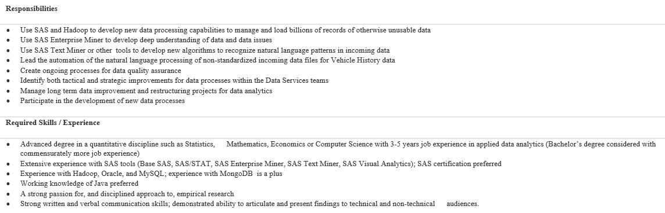
CARFAX data science job call

